Slide 1
Travel Insurance
Oracle Self Service

Slide 2
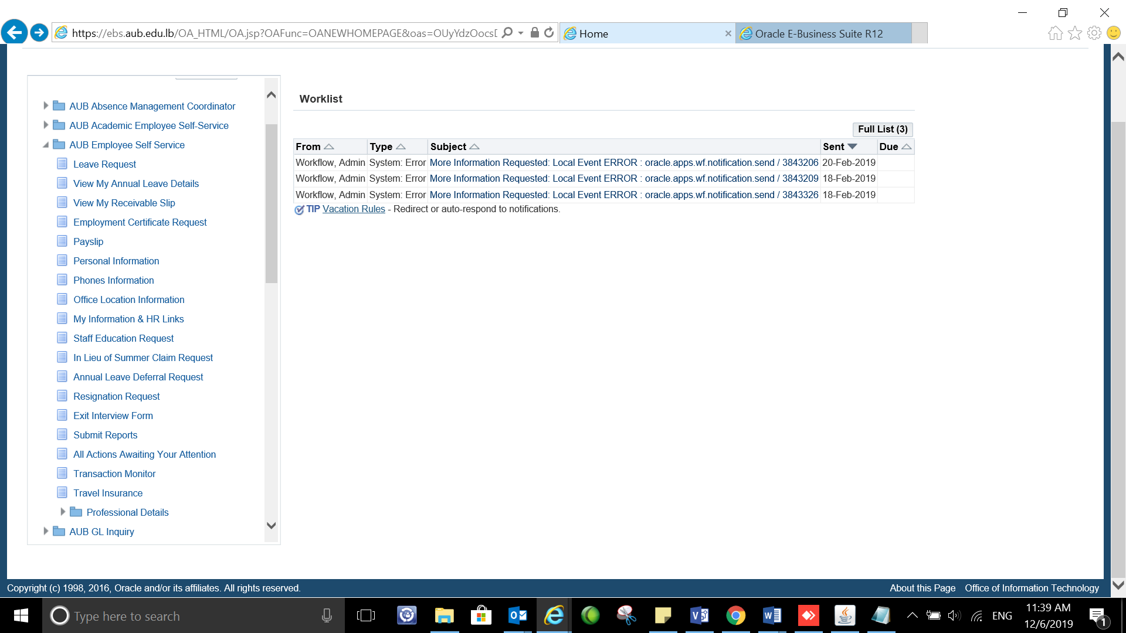
Login to Oracle: https://ebs.aub.edu.lb under AUB Employee self service choose Travel Insurance

Slide 3
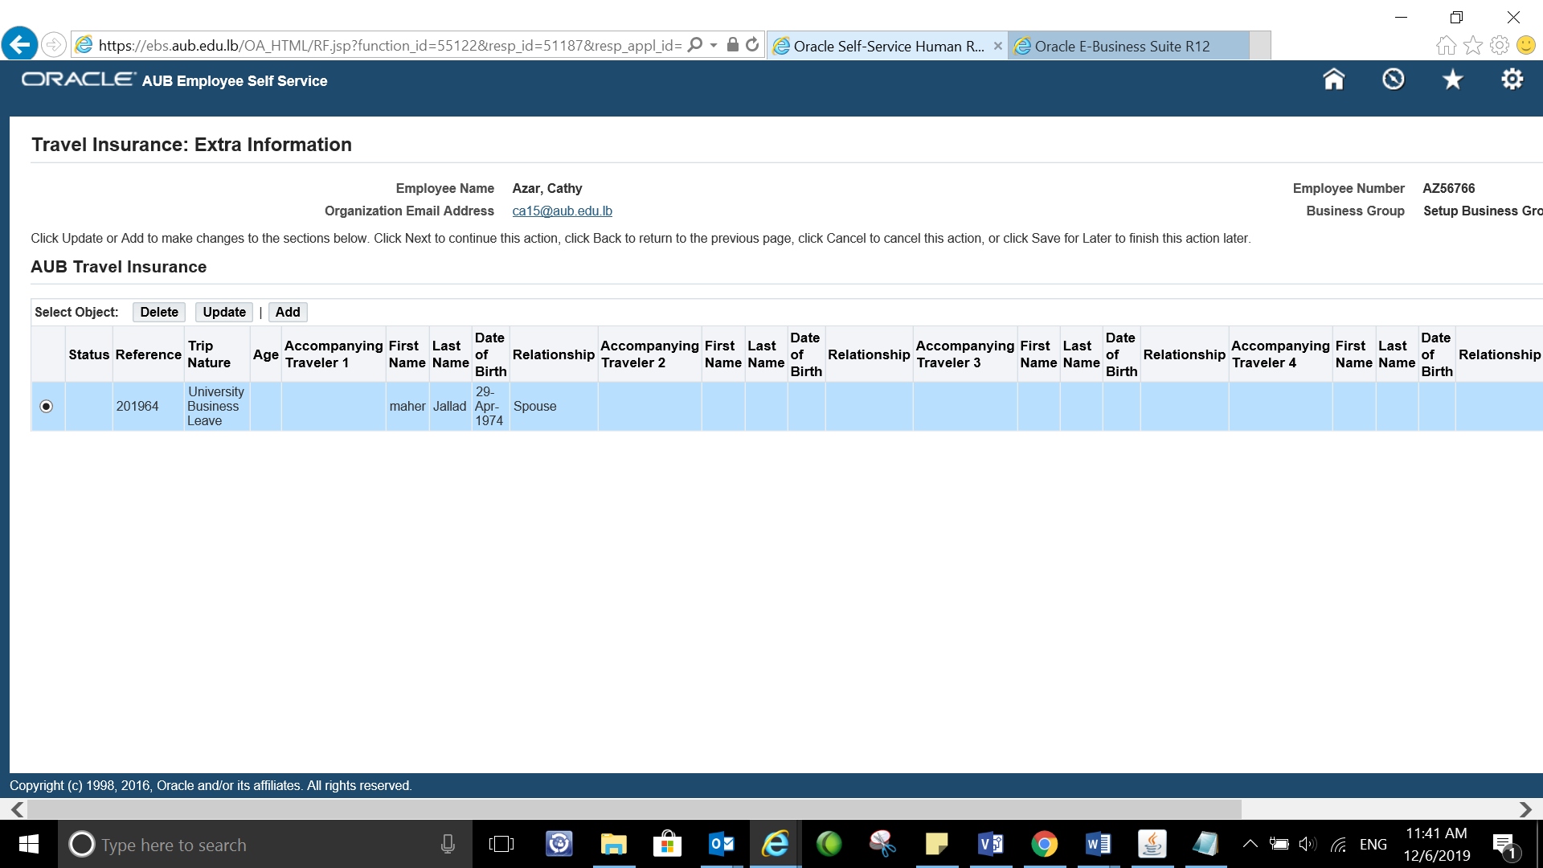
Select ADD to add a new travel insurance

Slide 4
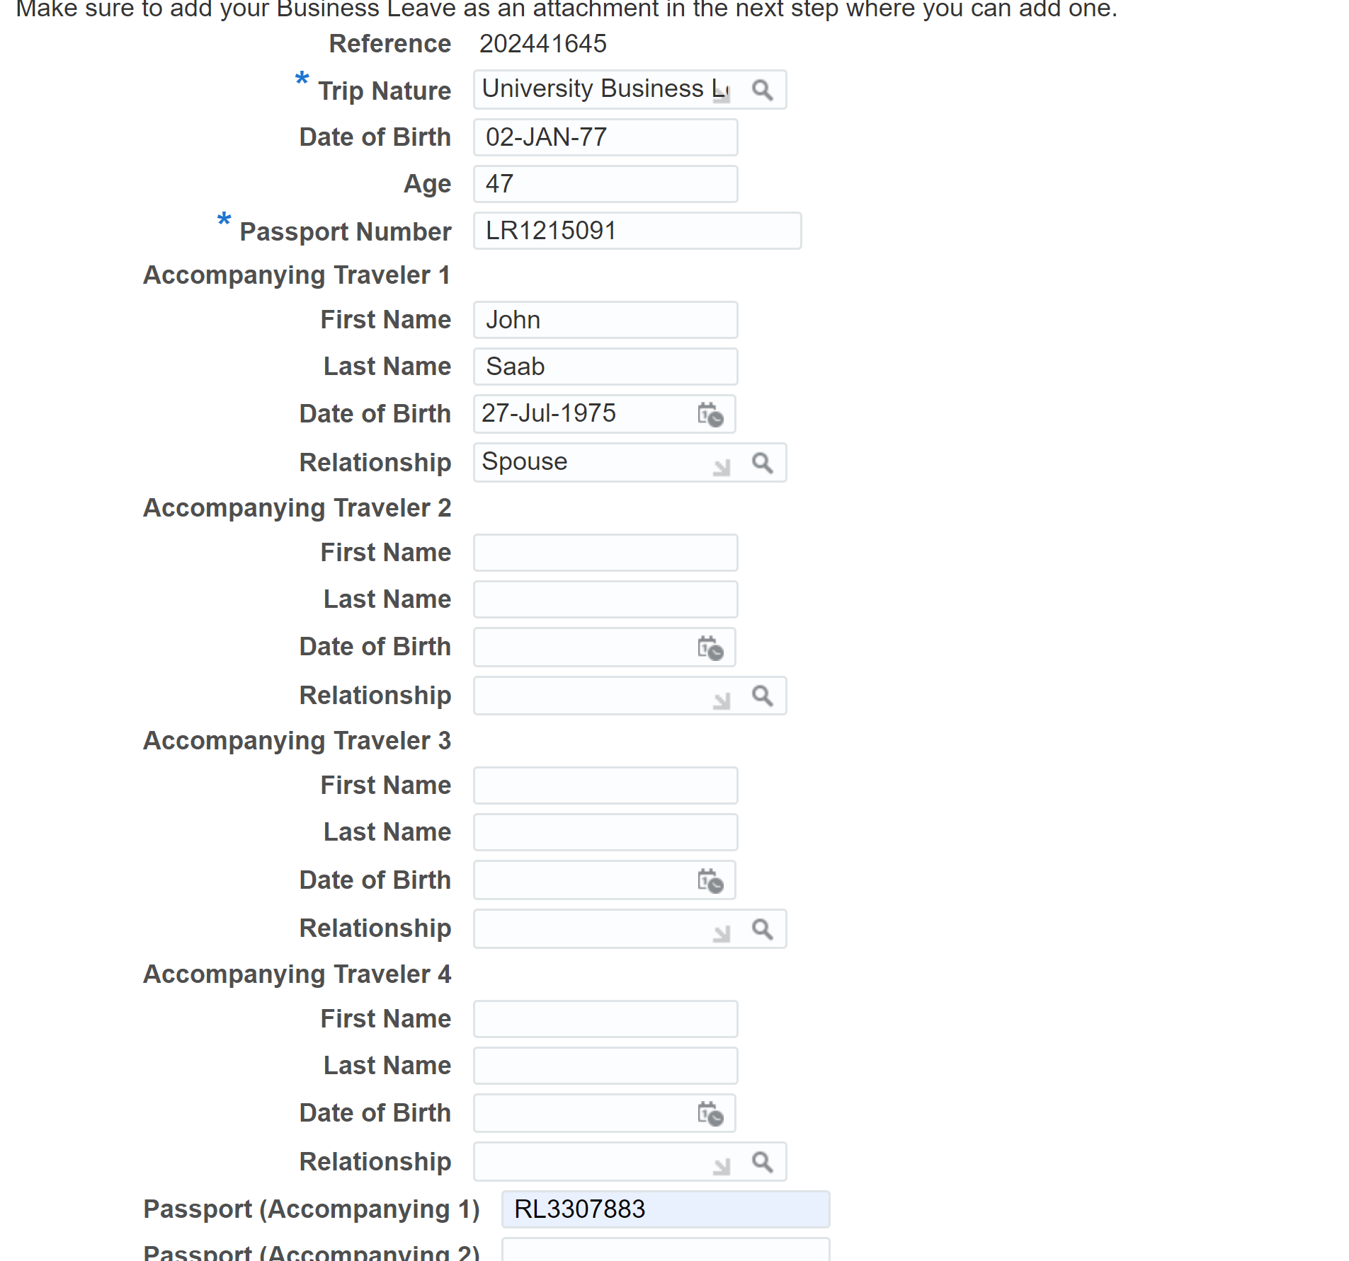
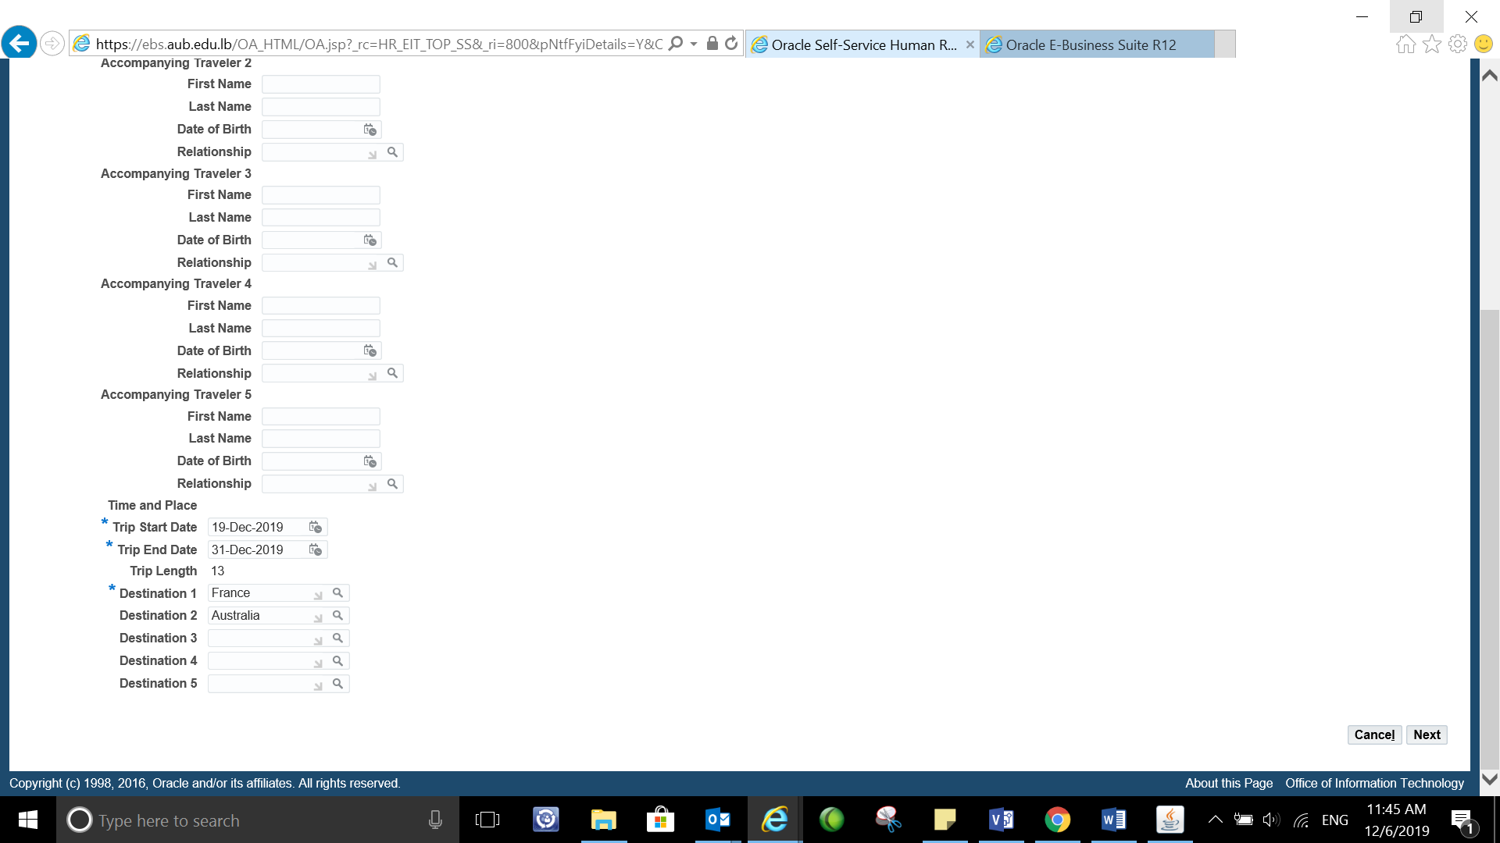
Example of filled travel insurance
Fill the required fields
Trip nature, Passport number,
Accompanying travelers(if applicable), date of birth, relationship, Passport number for Accompanying travelers, Trip dates, and destination

Slide 5
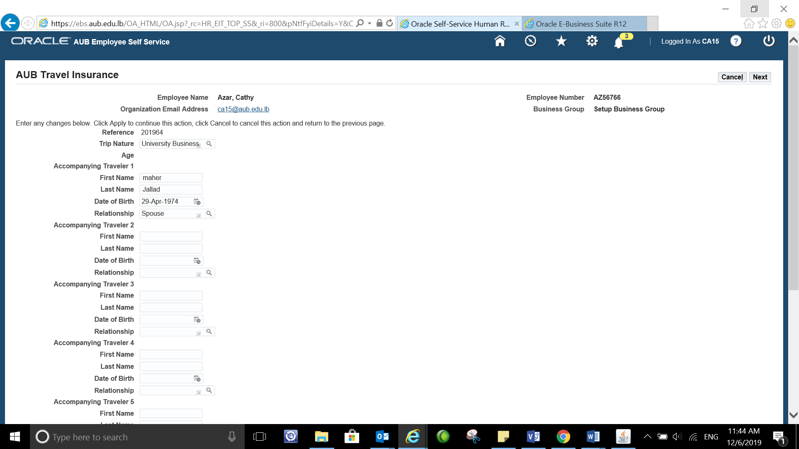
Example of filled travel insurance
Fill the required fields
Trip nature, Passport number,
Accompanying travelers(if applicable), date of birth, relationship, Passport number for Accompanying travelers, Trip dates, and destination

Slide 6
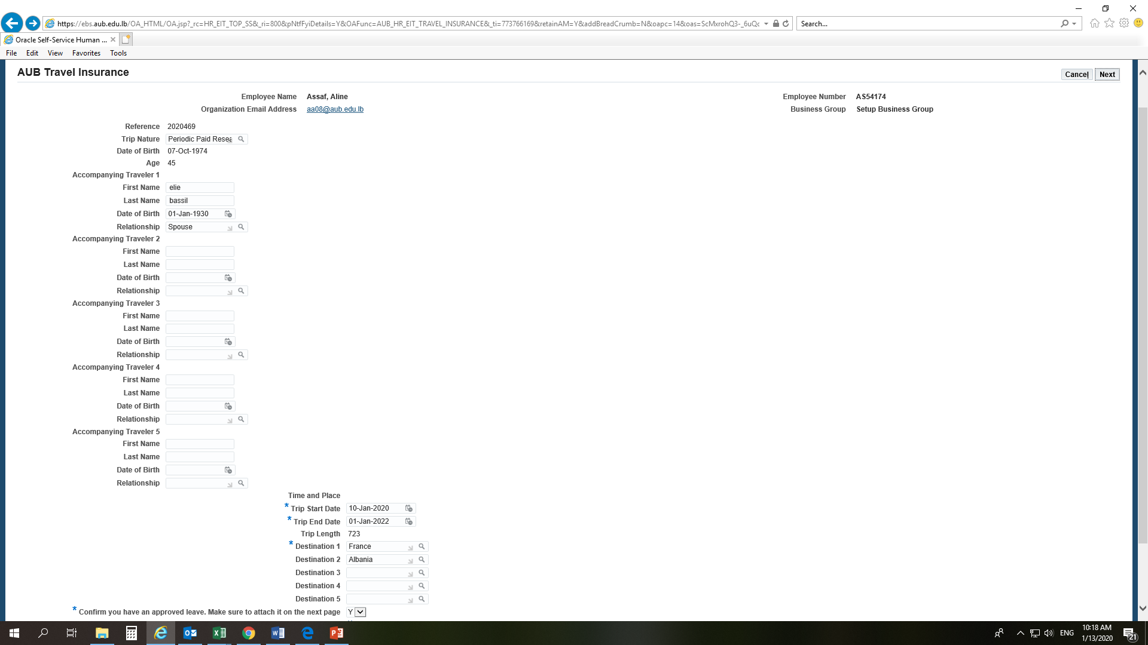
Example of filled travel insurance
Press NEXT to open the window where you need to upload the leave request

Slide 7
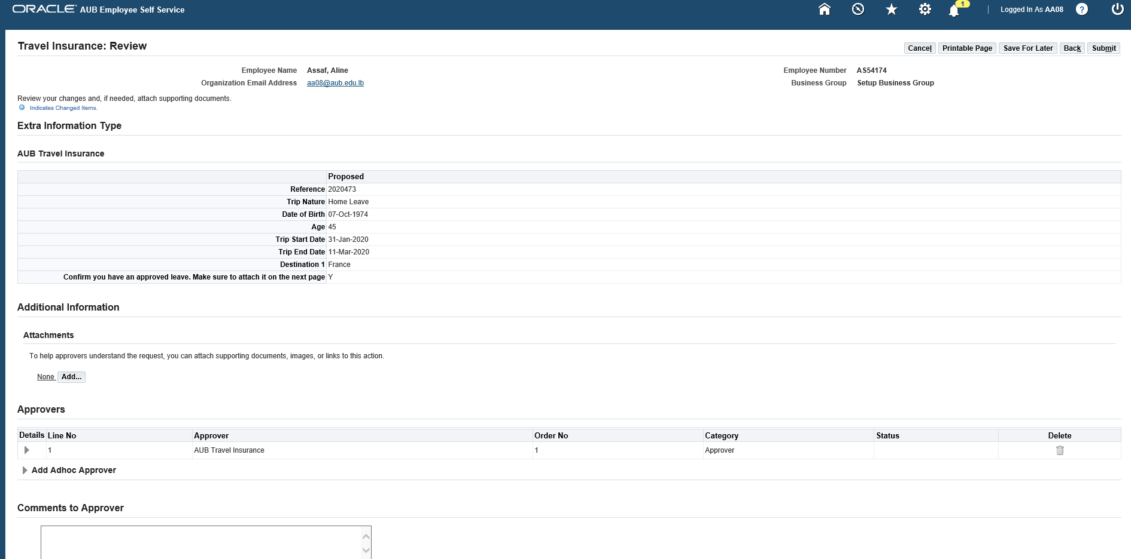
Approved leave request should be attached
Select ADD to upload your approved leave request

Slide 8
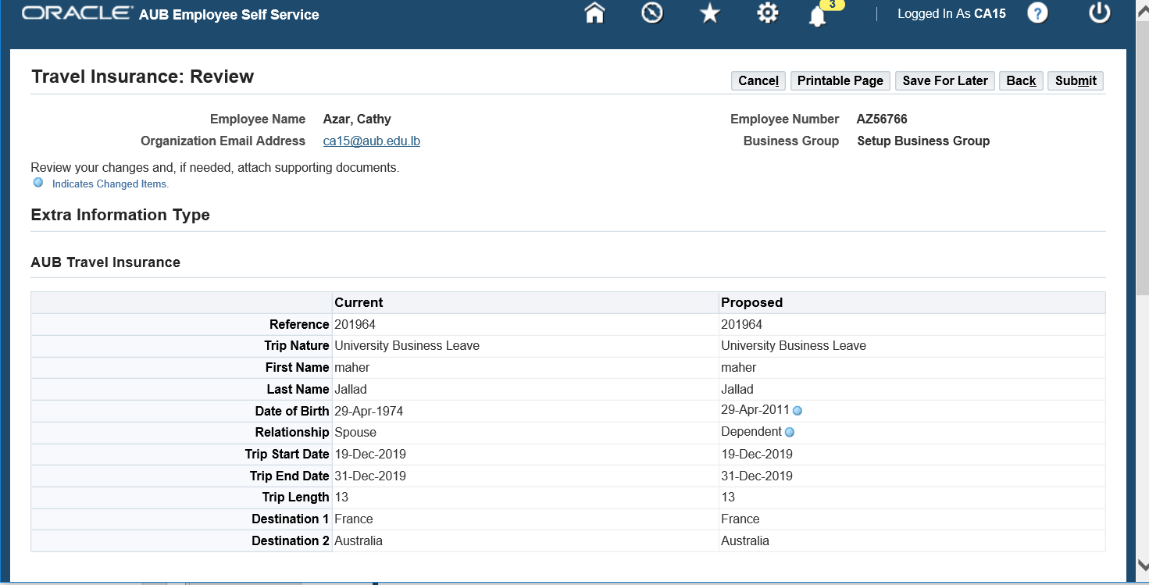
The system will show you a summary page of your request with the list of approvers beneath it. Click Submit
Enjoy your trip ☺

